Slide 1
GRADUATE Exit survey Class of 2017/2018
Prepared by the Analytics & Institutional Research Unit
Ms Takalani Muloiwa & Dr Mxolisi Masango

Slide 2
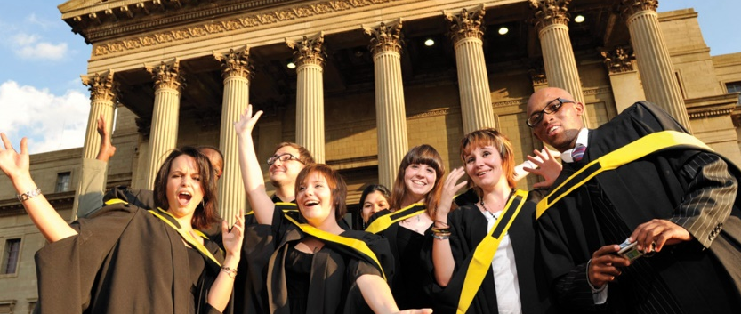
Introduction
The Graduate Exit Survey (GES) is administered by the Analytics & Institutional Research Unit (AIRU) during all university graduation ceremonies.
The GES is aimed at determining graduates employment status at the time of graduation.
Key questions in the GES
Employment status
Time to employment
Organization of employment
Institution of further study

Slide 3
Introduction
The current GES results are the interim results for the class of 2017/2018.
The final report will be made available in early 2019 once data from the December 2018 graduates has been collected.

Slide 4
Data Collection Process
The EGO informs qualified students about the GES in the graduation letter which is sent to students prior to graduations.
AIRU intern places an A5, 1-page survey on each graduate’s seat, together with a Wits branded pen.
AIRU intern encourages graduates to complete the survey (and all other graduation forms) and submit survey before the ceremony begins.
Graduates who did not submit the survey to the intern submit it into the GES Survey box when they go on stage.
At the beginning of 2018, AIRU solidified a partnership with EGO to ensure increased response rate in the GES.

Slide 5
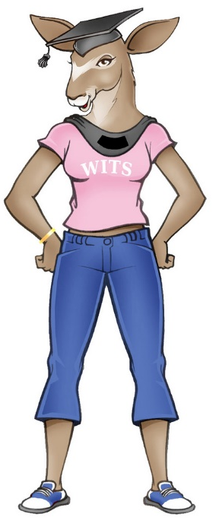
Overall Response Rate
The overall response rate has increased by 20%!
The response rate was worked out on the number of graduates that qualified to graduate. The 2016 data was excluded because of the poor response rate and the missing fields.

Slide 6
Response rate: 2017 Vs. 2018
Change drivers
Overall
AIRU partnership with EGO
GES is administered during graduation and not online
EGO includes information about the GES in the graduation letter
Graduation ushers & EGO staff are pre-informed about the GES
AIRU provides a Wits branded pen to all graduates together with the survey (incentive)
CLM
EBE
HS
HUM
SCI

Slide 7
Respondents Demographics
1) Gender Distribution 2) Race Distribution
3) Citizenship Status 4) School Quintile Distribution

Slide 8
Respondents Graduation Information
1) Graduation Qualification 2) Graduation Qualification Level
The distribution of postgraduate (PG) graduates has increased from 32% for the class of 2014/2015 to 41% for the class of 2017/2018

Slide 9
Employment Status
61% of employed graduates completed their qualifications within the minimum required time
The employment rate decreased from 56% in the class of 2014/2015 to 52% in the class of 2017/2018. However, there has been an 8% increase in the graduates who are furthering their studies and a 2% decrease in the unemployment rate.

Slide 10
Employment Patterns
1) Time to Employment 2) Job Related to Field of Study
degree completion
3) Employment Sector 4) Top 10 Employers
“Government, Education” refers to South African Department of Education [Schools]
Majority of employed graduates (97%) found employment within 6 months of completion. This is a 4% increase from the previous graduation class.

Slide 11
Graduates Furthering their Studies
1) Graduation Qualification 2) Graduation Qualification Level
3) Time to Degree Completion 4) Institutions of Further Study
76% of graduates who had completed an undergraduate degree were furthering their studies. Majority of the graduates (89%) indicated that they would be furthering their studies at Wits University.

Slide 12
GES Highlights
Majority of graduates who were employed by the time they graduated had been employed within 6 months of completing their qualifications.
The top 10 employers of Wits graduates include the “Big Four Auditors” i.e. KPMP, Deloitte, EY & PWC
A higher percentage of graduates who completed their qualifications in minimum time were furthering their studies.
Generally, Wits UG graduates pursue further studies prior to pursuing employment

Slide 13
Review of the Cross Faculty Interim Data Report

Slide 14
Cross-Faculty Highlights
Commerce, Law & Management
High percentage of students completed within minimum time (72%)
CLM reported the highest employment rate across the faculty’s (60%)
A high 31% of unemployed graduates are LLB graduates
A high 94% of those who graduated with a bachelors degree reported that they are furthering their studies
Engineering & the Built Environment
Faculty has the Highest unemployment rate (32%)
EBE has the lowest percentage of graduates who completed their qualifications within minimum time
A high 71% are employed in jobs directly related to their field of study
EBE has the lowest percentage of graduates who are furthering their studies
Interesting shift in the race demographics of EBE graduates furthering studies- majority white (43%)
Notes:
Probably because of MBA students

Slide 15
Cross-Faculty Highlights
Health Sciences
Health Sciences has a concerning high unemployment rate (32%)
Half of the graduates are employed within the government sector
A high 72% of graduates are employed in a job that is directly related to what they studied
Humanities
Very high percentage of students who completed within minimum time (76%)
A high percentage of unemployed Graduates (29%) were graduates of BA general degrees
A high 31% of graduates indicated that they were furthering their studies
Of those furthering their studies, 76% had completed a bachelors degree
Notes:
HS- possible reasons would be- medicine students awaiting placement

Slide 16
Cross-Faculty Highlights
Science
Science has the highest percentage of students who are furthering their studies (53%)
More than half of the unemployed graduates were graduates of BSc general degrees
Over 70% of employed graduates were graduates of postgraduate qualifications

